Slide 1

BUBBLEGUM
A MUSICAL FOR YOUNG PEOPLE
(WARNING: This show is likely to be offensive to parents)
BY PETER SPENCE
WARNING: The information and concepts contained within this document are confidential and must be not utilised or disclosed without the consent of the author © Peter Spence 1988

Slide 2
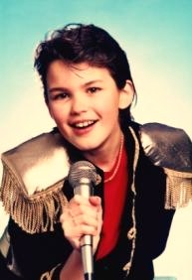

SYNOPSIS
‘BUBBLEGUM’ IS A SURREAL TAKE ON THE MUSIC BUSINESS
‘Flavour’ is a teenage boy popstar and is a virtual prisoner in ‘The Bubble,’ the corporate mansion of the Bubble Music Label, where under the constant watch of his chronically vain and obscenely rich manager and his security henchmen, he is forced to churn out songs of his angst-ridden soul. Corporately owned, The Bubble is a money-making popstar-factory and Flavour is only their current top-liner, where deprived of access to television, or newspapers, internet, mobile phone or social networking and conveyed to and from his concerts in blacked out limos, he is cocooned from any contact with the outside world and ordinary life which he longs to experience .
'Pristine' is a teenage girl at a nearby exclusive but cash-strapped Finishing School – Madame Myrtle’s Hooveroid Academy – which takes in lively young ladies and trains them to be servile housewives and mothers under the iron rod of its imperious Principal, Madame Myrtle. The Academy is under threat of closure and is on the look out for rich benefactors to bail it out. Here Pristine and her schoolmates, in contrast to Flavour, have their noses rubbed in ordinary and humdrum life and anything pertaining to finer feelings or emotions is roundly disapproved of. They long for a bit of glitz and glamour.
Their worlds are poles apart, and the chances of Flavour and Pristine ever meeting are remote, let alone their falling in love. Yet it happens when they meet on the only ‘neutral’ territory between their respective institutions – the ashram of the bogus, flamboyant and self-serving guru Moneygrub Gaga – the Grand High Dolby – the only person whom Flavour is allowed to visit, but just for the spiritual counselling to inspire the songs. Here, Flavour manages to give his minders the slip disguised as a maintenance man and Pristine, suddenly talent-spotted as a potential popstar, finds herself being marched off to the Bubble .
WARNING: The information and concepts contained within this document are confidential and must be not utilised or disclosed without the consent of the author © Peter Spence 1988

Slide 3

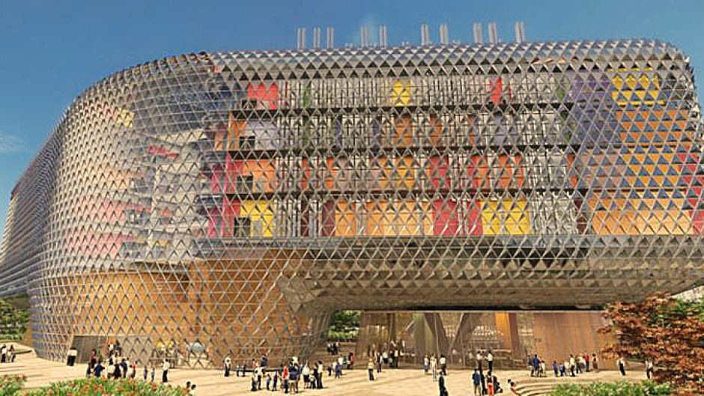
SYNOPSIS
CONTINUED
All hell breaks loose when they are reported ‘missing’ and the double search for them begins, the Hooveroid Academy being the last place anyone would look for Flavour, the same going for Pristine, now undergoing a Bubble-style makeover. So there is plenty of time for them to experience their new environments. Flavour has the time of his life at the Academy finding out about ordinary life, though he doesn’t quite know what to make of it all and finds himself out of his depth. Madame Myrtle buoyed by finding a rich mystery benefactor to save the college mistakes Flavour for the maintenance man he is now dressed as and treats him with all the hauteur at her disposal. The penalty for Flavour’s breach of Bubble protocol is that the management writes him off, and the pressure is on to launch Pristine as the next teenage sensation to replace him.
Once he hears what is happening to Pristine, Flavour, joined by the girls (and even Madame Myrtle herself) sets off on a full-scale attack on the Bubble to rescue her. Their plan is to expose the whole pop star exploitation racket for what it is and bring it to an end. After a successful invasion, the lovers are brought together again but a problem arises when the identity of the mogul behind the Bubble’s whole operation is revealed: it turns out to be Pristine’s own father, also the very ‘mystery benefactor’ who has saved the Hooveroid Academy from closure. Promising to mend his ways, he negotiates a compromise whereby he packages Flavour and Pristine together as a duo and launches them as the next teenage sensation but without any restrictions on their freedoms or relationship.
WARNING: The information and concepts contained within this document are confidential and must be not utilised or disclosed without the consent of the author © Peter Spence 1988

Slide 4
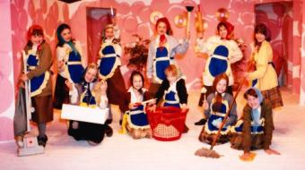
IMAGES
WARNING: The information and concepts contained within this document are confidential and must be not utilised or disclosed without the consent of the author © Peter Spence 1988

Slide 5

THE SCENES
The story takes place between the following scenes:
.
THE BUBBLE: - the well protected head-quarters of Bubble Records, and sheltered home of their money-spinning pop-star FLAVOUR.
MADAM MYRTLE'S HOOVEROID ACADEMY - an Alternative Finishing School, dedicated to turning out innocent young girls as middle-aged housewives.
THE TEMPLE OF THE GRAND HIGH DOLBY where GURU MONEYGRUB GAGA spiritual adviser to the stars, and millionaire holds court.
WARNING: The information and concepts contained within this document are confidential and must be not utilised or disclosed without the consent of the author © Peter Spence 1988

Slide 6
MAIN CHARACTERS
BUBBLE RECORDS
FLAVOUR
Rockstar, Prince of Sob
HEAP
his Manager
HOOD
His minder
HENCH
His other minder
THE BACKING GROUP
ANATHEMA
CLEAROCIL
SIDE SALAD
his Pal
OTHER SIGNIFICANTS
GURU MONEYGRUB GAGA
BOD SQUENCH
Guru's Acolyte
TIGHTWAD
a rich Tycoon
TOUCHWOOD
the Caretaker
HOOVEROID ACADEMY
PRISTINE
Academy Student
CREDA
her Room Mate
MADAM MYRTLE College Principal
CHORUS
HOOVEROIDS
GURU'S DEVOTEES
BUBBLIES
WARNING: The information and concepts contained within this document are confidential and must be not utilised or disclosed without the consent of the author © Peter Spence 1988

Slide 7
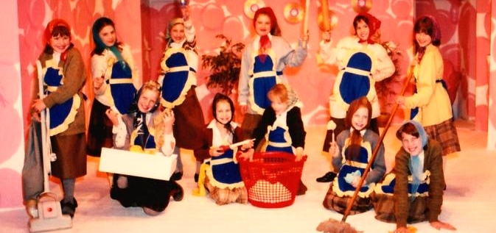
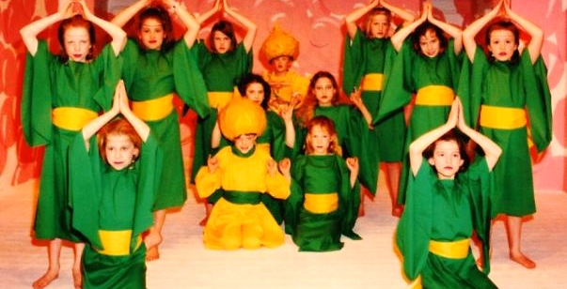
CHORUS
HOOVEROID ACADEMY STUDENTS
SOPHIE
(MRS) BROBAT
(MRS) SWARFEGA
(MRS) CLINGFILM
(MRS) FLYMO
DEVOTEES OF GURU GAGA
MAGGOT
SLUG
WART
BOG
WORM
SLIME
MUCK
WARNING: The information and concepts contained within this document are confidential and must be not utilised or disclosed without the consent of the author © Peter Spence 1988

Slide 8
THE SONGS
1. Too ‘Merch’ Too Soon
2. Crush the Cockroach Rap
3. Looking for Love
4. A Woman’s Place
5. Looking for Love reprise
6. He Knows, He Knows
7. Looking for Love
8. Hooveroid Rinse
9. Sugar Daddy
10. Looking for Love (concluding song version)
WARNING: The information and concepts contained within this document are confidential and must be not utilised or disclosed without the consent of the author © Peter Spence 1988

Slide 9
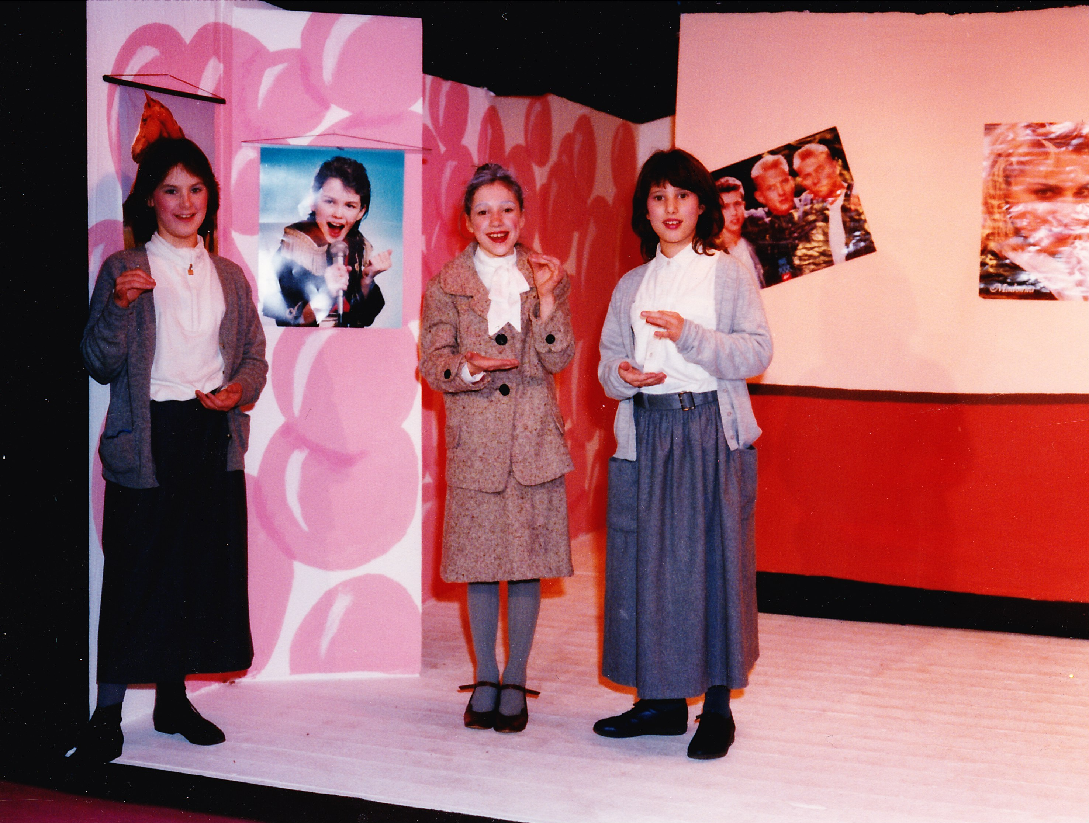

Audio
Click here to listen to “A Woman’s Place”

Slide 10
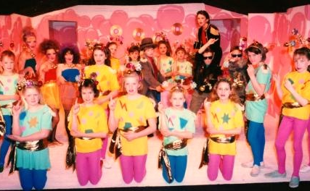
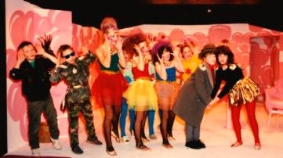

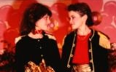
IMAGES
BUBBLEGUM
WARNING: The information and concepts contained within this document are confidential and must be not utilised or disclosed without the consent of the author © Peter Spence 1988

Slide 11
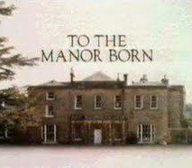
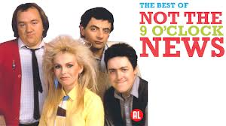

ABOUT THE AUTHOR
PETER SPENCE IS PRIMARILY KNOWN FOR CREATING AND WRITING AWARD WINNING TELEVISION
Perhaps he is best known for creating and writing the BBC sitcom “To the Manor Born” starring Penelope Keith and Peter Bowles.
He has written for a number of top comedy stars and sketch shows including “Not The Nine O’Clock News” with Rowan Atkinson and Grifff Rhys Jones.
He is a pianist and songwriter and performs a one man show entitled “Maybe I should get out more”.
More recently he has turned his hand to murder mystery, writing episodes of “Rosemary and Thyme.”
He originally wrote Bubblegum musical for his daughters’ drama group.
WARNING: The information and concepts contained within this document are confidential and must be not utilised or disclosed without the consent of the author © Peter Spence 1988

Slide 12
CONTACT
AUTHOR
Peter Spence
Email: spencepdr@hotmail.com
Phone: 0777 574 4520
AUTHOR’S REPRESENTATIVE
Juliet Grant
Email: julietgrant@btinternet.com
Office: 01306 743 191
Mobile: 07879 471 622
WARNING: The information and concepts contained within this document are confidential and must be not utilised or disclosed without the consent of the author © Peter Spence 1988

Slide 13
AGENT
PRODUCTION HISTORY
1. The original musical was written in 1988 for a local children’s drama group ‘Young Stagers’ (Ages 7-11) which is part of the Dorking Dramatic and Operatic Society (DDOS)
2. It was first performed in December 1988 at The Green Room Theatre, in Dorking, Surrey.
3. Bubblegum has also been performed ‘in the round’ as a secondary school production at Ringmer School, Sussex.
4. Although written in the 1980’s and as a musical it would work brilliantly set in the ‘80s, the script is in the process of being updated to include references to social media, the internet and other technological advances to make it more relevant to today’s audience.
WARNING: The information and concepts contained within this document are confidential and must be not utilised or disclosed without the consent of the author © Peter Spence 1988

Slide 14
BUBBLEGUM
A MUSICAL FOR YOUNG PEOPLE
(WARNING: This show is likely to be offensive to parents)
BY PETER SPENCE
WARNING: The information and concepts contained within this document are confidential and must be not utilised or disclosed without the consent of the author © Peter Spence 1988

