Slide 1
BUBBLEGUM
A MUSICAL FOR YOUNG PEOPLE
(WARNING: This show is likely to be offensive to parents)
BY PETER SPENCE
WARNING: The information and concepts contained within this document are confidential and must be not utilised or disclosed without the consent of the author © Peter Spence 1988

Slide 2
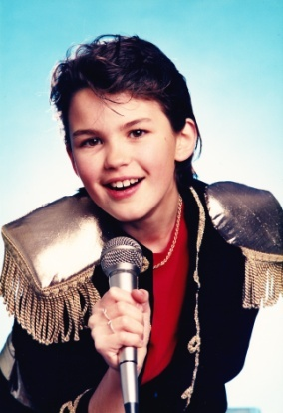
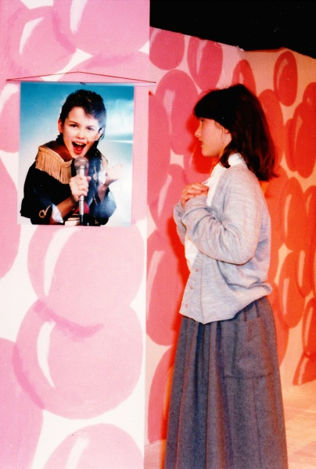
SYNOPSIS
‘Flavour’ is a teenage boy pop-star and is a virtual prisoner in ‘The Bubble,” the corporate mansion of the Bubble Music Label, where under the constant watch of Herman Heap – his chronically vain and obscenely rich manager – and his henchmen, he is forced to churn out songs of his angst-ridden soul. The Bubble is a money-making star-factory and Flavour is only their current top-liner, where deprived of access to television, or newspapers, internet, mobile phone or social networking and conveyed to and from his concerts in blacked out limos he is cocooned from any contact with the outside world and ordinary life which he longs to experience.
Pristine is a teenage girl at a nearby Finishing School – Madame Myrtle’s Hooveroid Academy – which takes in lively young ladies and trains them to be servile housewives and mothers under the iron rod of its imperious Principal, Madame Myrtle. She and her college mates, in contrast to Flavour, have their noses rubbed in ordinary and humdrum life and anything pertaining to finer feelings or emotions is roundly disapproved of. They long for a bit of glitz and glamour.

Slide 3
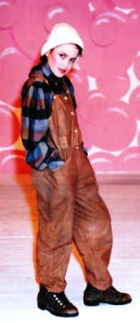
SYNOPSIS cont.
Their worlds are poles apart, and the chances of Flavour and Pristine ever meeting are remote, let alone their falling in love. Yet it happens when they meet on the only ‘neutral’ territory between their respective institutions – the ashram of the bogus and flamboyant self-serving Guru Gaga – the Grand High Dolby – the only person whom Flavour is allowed to visit but just for his spiritual counselling. Here, Flavour manages to give his minders the slip disguised as a maintenance man and, talent-spotted as a potential pop-star herself, Pristine finds herself being marched off to the Bubble .
All hell breaks loose when they are reported ‘missing’ and the double search for them begins, the Hooveroid Academy being the last place anyone would look for Flavour, the same going for Pristine, now undergoing a Bubble-style makeover. So there is plenty of time for them to experience their new environments. Flavour has the time of his life at the Academy finding out about ordinary life, though he doesn’t quite know what to make of it all and finds himself out of his depth. However, the penalty for his breach of Bubble protocol is that the management writes him off, and the pressure is on to launch Pristine as the next teenage sensation to replace him.

Slide 4
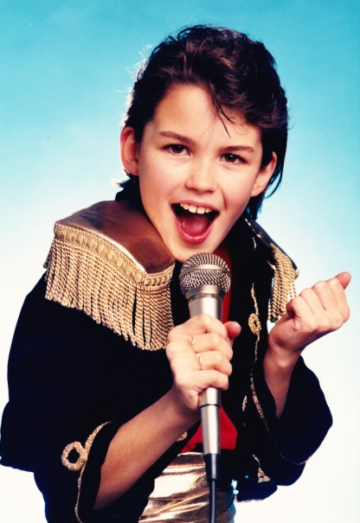
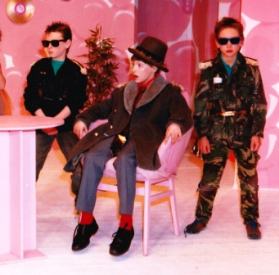
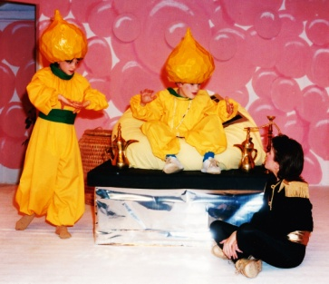
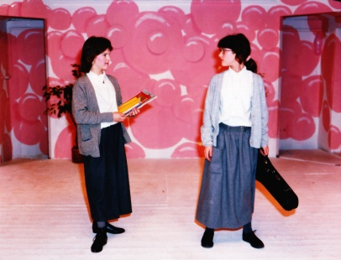
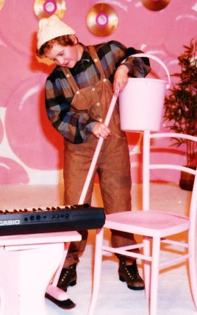
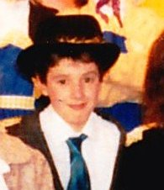
MAIN CAST OF CHARACTERS
FLAVOUR Rockstar, Prince of Sob
HEAP his Manager
HOOD and HENCH his Minders
THE BACKING GROUP:
ANATHEMA
CLEAROCIL
SIDE SALAD/ his Pal
GURU MONEYGRUB GAGA
BOD SQUENCH Guru's Acolyte
PRISTINE Hooveroid Academy Student
CREDA her Room Mate
TOUCHWOOD the Caretaker
TIGHTWAD a rich Tycoon
MADAM MYRTLE College Principal
CHORUS OF HOOVEROIDS, GURU'S DEVOTEES, and BUBBLIES

Slide 5
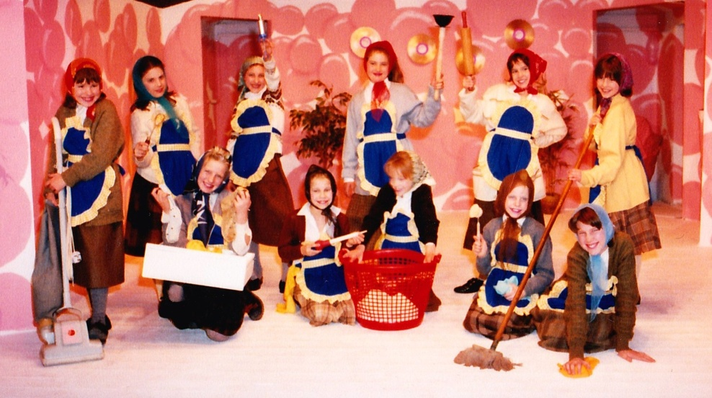
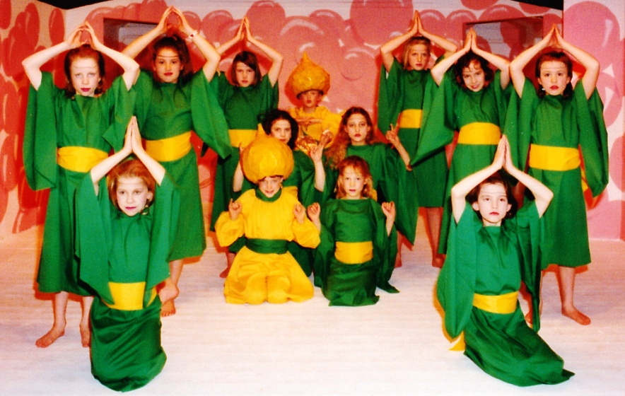
CHORUS Parts
Hooveroid Academy Students including:
Sophie
(Mrs) Brobat
(Mrs) Swarfega
(Mrs) Clingfilm
(Mrs) Flymo
Devotees of Guru GAGA
Maggot
Slug
Wart
Bog
Worm
Slime
Muck

Slide 6
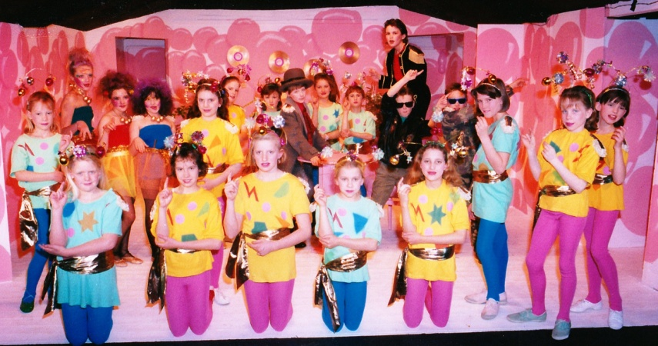
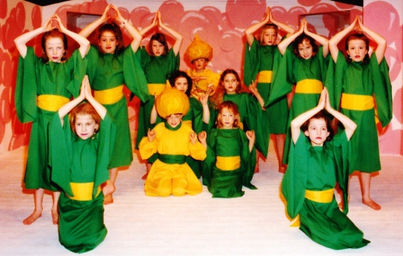
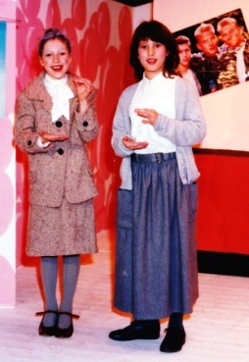
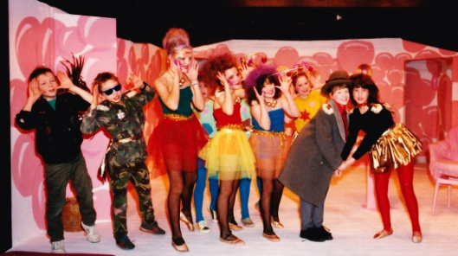
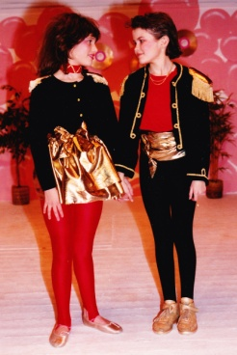
SONGS
Too ‘Merch’ Too Soon
Crush the Cockroach Rap
Looking for Love
A Woman’s Place
Looking for Love reprise
He Knows, He Knows
Looking for Love
Hooveroid Rinse
Sugar Daddy
Looking for Love (concluding song version)

Slide 7
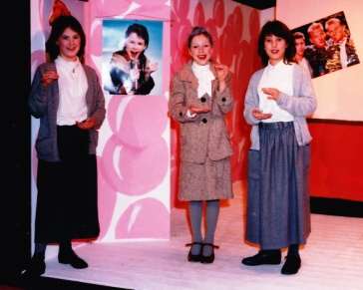
Audio: A Woman’s Place
Sung by Madame Myrtle, Creda and Pristine

Slide 8
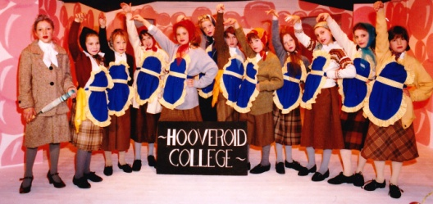
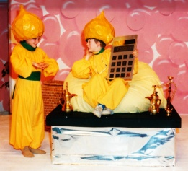
SCENES
The story takes place between the following scenes:
THE BUBBLE: - the well protected head-quarters
of Bubble Records, and sheltered home of their
money-spinning pop-star FLAVOUR.
MADAM MYRTLE'S HOOVEROID ACADEMY - an Alternative Finishing School, dedicated to turning out innocent young girls as middle-aged housewives.
THE TEMPLE OF THE GRAND HIGH DOLBY where GURU MONEYGRUB GAGA spiritual adviser to the stars, and millionaire holds court

Slide 9
Contact INFORMATION
Peter Spence
Email: spencepdr@hotmail.com
Mobile: 07775744520
Address: 10 a Cliftonville, Dorking, Surrey RH4 2JG
Author’s Representative: Juliet Grant
Email: julietgrant@btinternet.com
Phone: 01306 743191
Mobile: 07879471622

Slide 10
Production History
The original musical was written in 1988 for a local children’s drama group ‘Young Stagers’ (Ages 7-11) which is part of the Dorking Dramatic and Operatic Society (DDOS)
It was first performed in December 1988 at The Green Room Theatre in Dorking.
Bubblegum has also been performed ‘in the round’ as a secondary school production at Ringmer School, Sussex.
Although written in the 1980’s and as a musical it would work brilliantly set in the ‘80s, the script has been recently updated to include references to social media, the internet and other technological advances to make it more relevant to today’s audience.

Slide 11
ABOUT THE SCRIPT WRITER
Peter Spence writes primarily for television and is perhaps best known for creating and writing the sit-com “To the Manor Born.”
He has written for a number of top comedy stars and sketch shows including “Not The Nine O’Clock News.” More recently he has turned his hand to murder mystery, writing episodes of “Rosemary and Thyme.”
He is a talented musician and singer/songwriter and performs a one man show.
He originally wrote this musical for his daughters’ drama group.

